Slide 1

Introduction to Managerial Accounting
Chapter 1
Notes:
Chapter 1 introduces us to Managerial Accounting.

Slide 2
Objective 1
Identify managers’ three primary responsibilities
Notes:
There are three primary managerial accounting responsibilities. These three responsibilities are the topic of Learning Objective 1.

Slide 3
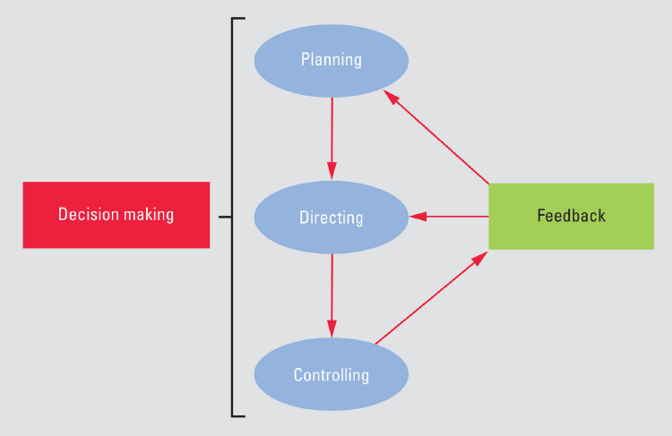
Managers’ Responsibilities
Notes:
Managerial accounting helps managers fulfill their three primary responsibilities: Planning, Directing, and Controlling.

Slide 4
Planning
Setting goals and objectives and how to achieve them
Examples of planning
Generate more sales via opening new stores
Reduce labor costs by reducing store hours
Budgets
Notes:
Planning involves setting goals and objectives for the company and determining how to achieve them. For example, one of Chipotle’s goals is to generate more sales. One strategy to achieve this goal is to open more restaurants. Managerial accounting translates these plans into budgets—the quantitative expression of a plan. Management analyzes the budgets before proceeding to determine whether its expansion plans make financial sense.

Slide 5
Directing
Overseeing company’s day-to-day operations
Examples
Using daily/weekly sales reports to adjust marketing strategies
Using product cost reports to adjust raw material usage
Notes:
Directing means overseeing the company’s day-to-day operations. Management uses product cost reports, product sales information, and other managerial accounting reports to run daily business operations. For example, Chipotle uses product sales data to determine which menu items are generating the most sales, and then uses that information to adjust menus and marketing strategies.

Slide 6
Controlling
Evaluating results of operations against plans and making adjustments as needed
Examples
Comparing budgeted sales with actual sales to take corrective actions
Comparing budgeted product costs against actual product costs to take corrective actions
Notes:
Controlling means evaluating the results of business operations against the plan and making adjustments to keep the company pressing toward its goals. Chipotle uses performance reports to compare each restaurant’s actual performance against the budget, and then uses that feedback to take corrective actions if needed. If actual costs are higher than planned, or actual sales are lower than planned, then management may revise its plans or adjust operations. Perhaps the newly opened restaurants are not generating as much income as budgeted. As a result, management may decide to increase local advertising to increase sales.

Slide 7
Objective 2
Distinguish financial accounting from managerial accounting
Notes:
Learning Objective 2 is the ability to distinguish financial accounting from managerial accounting. Financial accounting is primarily for external users. Managerial accounting is primarily for internal users. Over the next several slides, we will talk about specific differences between the two areas.

Slide 8
Managerial vs. Financial Accounting
Financial accounting:
1) Generally Accepted Accounting Principles and auditing required (SEC/ CPA)
2) what happened for each annual and quarter (reliable and objective)
Managerial accounting:
1) No GAAP-type standards or audits required
2) Focus on future, providing relevant information for decision-making and companies prepare and revise managerial accounting reports as often as needed

Slide 9
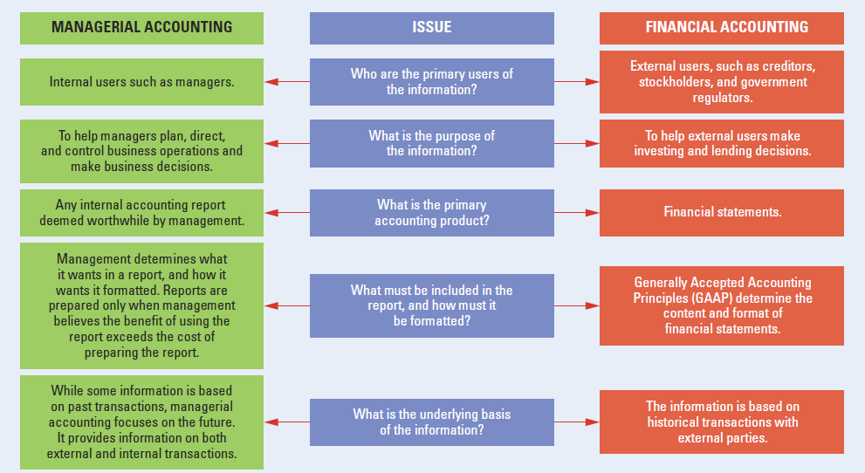
Managerial vs. Financial Accounting
Copyright © 2015 Pearson Education, Inc.
Notes:
Managerial accounting provides information to internal users; this will help managers direct, plan, control, and make decisions that impact the company. Financial accounting addresses external users and is geared toward making investment and lending decisions. In order to address decision-making needs, managerial accounting provides internal reports useful to management, while financial accounting provides general purpose financial statements, as determined by GAAP. Financial report data, initially based on historical transactions, must be reliable and objective.

Slide 10
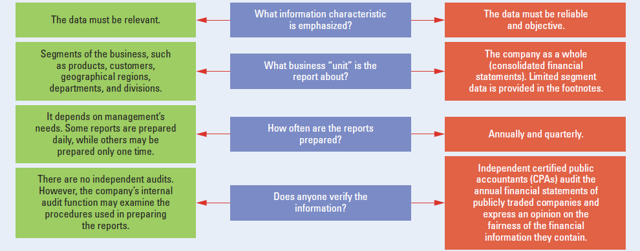
Managerial vs. Financial Accounting
Copyright © 2015 Pearson Education, Inc.
Notes:
Managerial report data must be relevant to the decisions that company management is required to make. Managerial accounting reports, prepared as needed for specific segments of the business, are verified by an internal audit. Financial accounting reports, prepared as required, are provided quarterly and annually, and are verified by external auditors.

Slide 11
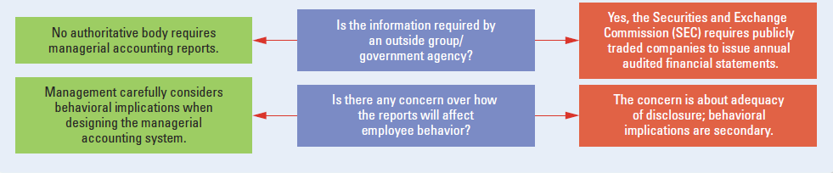
Managerial vs. Financial Accounting
Copyright © 2015 Pearson Education, Inc.
Notes:
Finally, managerial accounting reports, which do not have any formal legal information requirements, may have direct impact on employee behavior. Based on the potential of this, management must carefully consider how the system may affect employees’ behavior. The SEC requires publicly traded companies to issue audited financial statements that disclose information critical to investors. Usually, these financial accounting reports do not have impact on employee behavior.

Slide 12

Objective 3
Describe organizational structure and the roles and skills required of management accountants within the organization
Notes:
Learning Objective 3 describes organizational structure and the roles and skills required of management accountants within the organization.

Slide 13
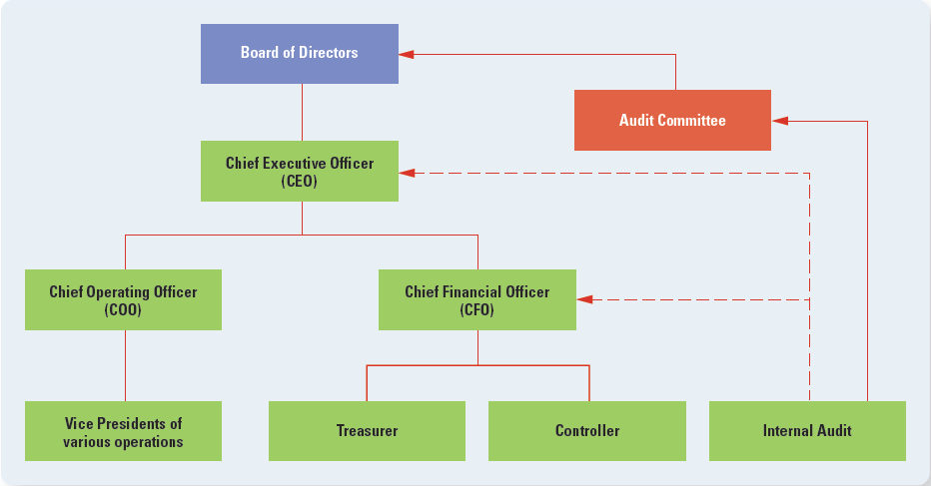
Organizational Structure
Copyright © 2015 Pearson Education, Inc.
Notes:
Stockholders elect a board of directors to oversee the company. The board meets only periodically, so it hires a chief executive officer (CEO) to manage the company on a daily basis. The CEO hires other executives to run various aspects of the organization, including the chief operating officer (COO) and the chief financial officer (CFO). The COO is responsible for the company’s operations, such as research and development (R&D), production, and distribution. The CFO is responsible for all of the company’s financial concerns. The treasurer and the controller report directly to the CFO. The treasurer is primarily responsible for raising capital (through issuing stocks and bonds) and investing funds. The controller is usually responsible for general financial accounting, managerial accounting, and tax reporting.
The New York Stock Exchange requires that listed companies have an internal audit function. The role of the internal audit function is to ensure that the company’s internal controls and risk management policies are functioning properly. The internal audit department reports directly to a subcommittee of the board of directors called the audit committee. The audit committee oversees the internal audit function as well as the annual audit of the financial statements by independent CPAs.

Slide 14
Organizational Structure
Audit committee:
1) Subcommittee of the board of directors and meet periodically
2) Oversees the internal audit function
3) Annual audit of the financial statements by independent CPAs
4) Also report to a senior executive, such as CFO or CEO, for administrative matters

Slide 15
Changing Roles of Management Accountants
Impact of technology
Ensuring accurate financial records
Planning, analyzing, and interpreting accounting data
Providing decision support
Notes:
Technology has changed the roles of management accountants. They are still involved with the traditional tasks of ensuring accurate financial records. However, computers have taken over the task of performing routine mechanical accounting tasks. Freed from the routine mechanical work, management accountants spend more time planning, analyzing, and interpreting accounting data to provide decision support.
Management accountants must still ensure that the company’s financial records adequately capture economic events. They help design the information systems that capture and record transactions and make sure that the information system generates accurate data. They use professional judgment to record nonroutine transactions and make adjustments to the financial records as needed. Management accountants still need to know what transactions to record and how to record them, but they let technology do most of the routine work.

Slide 16
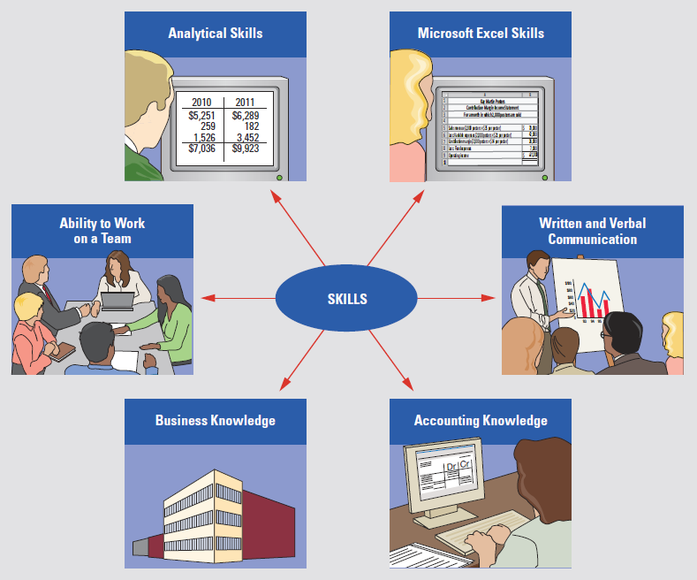
Required Skills of Managerial Accountants
Notes:
Today’s management accountant requires solid knowledge of both financial and managerial accounting, knowledge of how a business functions, the ability to work on a team, analytical skills, strong Microsoft Excel skills, and oral and written communications skills.

Slide 17
Objective 4
Institute of Management Accountants (IMA), ethical and illegal behaviors
Notes:
Learning Objective 4 describes the role of the Institute of Management Accountants (IMA) and how to use its ethical standards to make reasonable ethical judgments.

Slide 18
Institute of Management Accountants (IMA)
Professional association for management accountants
IMA’s functions
Certification (CMA)
Forum for research
Practice development
Education
Knowledge sharing
Ethical standards
Public education
Notes:
The Institute of Management Accountants (IMA) is the professional association for management accountants in the United States. The goal of the IMA is to advance the management accounting profession primarily through certification, research, practice development, education and knowledge sharing. The IMA issues one professional certification: the Certified Management Accountant (CMA). You can find out more about the IMA and the CMA at the IMA website www.imanet.org.

Slide 19
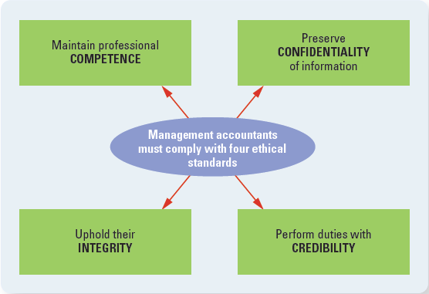
Summary of IMA Ethical Standards
Copyright © 2015 Pearson Education, Inc.
Notes:
The IMA Statement of Ethical Professional Practice requires compliance with four ethical standards: maintain professional competence, preserve confidentiality of information, uphold their integrity, and perform duties with credibility. Failure to comply with the standards may result in disciplinary action.

Slide 20
Ethical Behavior
Means doing the right thing, regardless of consequences
Examples of unethical behavior
Allowing reimbursement of false expense reports
Manipulating income
Performing tasks not qualified to perform
Notes:
Management accountants continuously face ethical challenges. The IMA has developed principles and standards to help management accountants deal with these challenges. The principles and standards remind us that society expects professional accountants to exhibit the highest level of ethical behavior. Ethical behavior means doing the right thing, regardless of the consequences. Consequences can make it difficult to decide what to do. Examples of unethical behavior:
Allowing reimbursement of false expense reports
Following the controller’s suggestion to manipulate income
Performing tasks that you do not feel qualified to perform

Slide 21
Steps to Resolve Ethical Dilemmas
Follow company’s policies for reporting unethical behavior
If not resolved
Discuss with immediate supervisor
Discuss with objective advisor
Consult an attorney
Notes:
To resolve ethical dilemmas, the IMA suggests that management accountants first follow their company’s established policies for reporting unethical behavior. If not resolved in this way, then you should discuss the situation with the immediate supervisor unless the supervisor is involved in the unethical situation. If the immediate supervisor is involved and is the CEO, you must notify the audit committee or board of directors. Discuss the unethical situation with an objective advisor, such as an IMA ethics counselor, for clarification. Consulting an attorney regarding legal obligations and rights is also advisable.

Slide 22
Unethical vs. Illegal Behavior
Not all unethical behavior is illegal, but all illegal behavior is unethical.
Unethical behavior includes
Dishonesty
Unfairness
Lack of objectivity
Irresponsibility
Notes:
Finally, is there a difference between unethical and illegal behavior? Not all unethical behavior is illegal, but all illegal behavior is unethical. For example, consider the competence standard. The competence standard states that management accountants have a responsibility to provide decision support information that is accurate, clear, concise, and timely. Failure to follow this standard is unethical but in most cases not illegal. Now, consider the integrity standard. It states that management accountants must abstain from any activity that might discredit the profession. A management accountant who commits an illegal act is violating this ethical standard. In other words, ethical behavior encompasses more than simply following the law.

Slide 23

Objective 5
Discuss and analyze the implications of regulatory and business trends
Notes:
Learning Objective 5 discusses regulatory and business trends.

Slide 24
Regulatory and Business Issues
Sarbanes-Oxley Act of 2002 (SOX)
International Financial Reporting Standards (IFRS)
Extensible Business Reporting Language (XBRL)
Sustainability
Shifting economy
Notes:
The business world is continuously changing. Let us look at some of the current regulatory and business issues that affect managers and the managerial accounting systems that support them. These issues include the Sarbanes-Oxley Act (SOX), International Financial Reporting Standards (IFRS), Extensible Business Reporting Language (XBRL), sustainability, and the shifting economy.

Slide 25
Sarbanes-Oxley Act of 2002 (SOX)
Restore trust in publicly traded corporations, management, financial statements, and auditors
SOX enhances internal control and financial reporting requirements and establishes new regulatory requirement for publicly traded companies and tehir independent auditors.
Notes:
As a result of corporate accounting scandals, such as those at Enron and WorldCom, the U.S. Congress enacted the Sarbanes-Oxley Act of 2002 (SOX). The purpose of SOX is to restore trust in publicly traded corporations, their management, their financial statements, and their auditors. SOX enhances internal control and financial reporting requirements and establishes new regulatory requirements for publicly traded companies and their independent auditors. Publicly traded companies have spent millions of dollars upgrading their internal controls and accounting systems to comply with SOX regulations.
SOX requires the company’s CEO and CFO to assume responsibility for the financial statements and disclosures. The CEO and CFO must certify that the financial statements and disclosures fairly present, in all material respects, the operations and financial condition of the company. Additionally, they must accept responsibility for establishing and maintaining an adequate internal control structure and procedures for financial reporting. The company must have its internal controls and financial reporting procedures assessed annually.
SOX also requires audit committee members to be independent, meaning that they may not receive any consulting or advisory fees from the company other than for their service on the board of directors. In addition, at least one of the members should be a financial expert. The audit committee oversees not only the internal audit function, but also the company’s audit by independent CPAs.
To ensure that CPA firms maintain independence from their client company, SOX does not allow CPA firms to provide certain nonaudit services (such as bookkeeping and financial information systems design) to companies during the same period of time in which they are providing audit services. If a company wants to obtain such services from a CPA firm, it must hire a different firm to do the nonaudit work. Tax services may be provided by the same CPA firm if preapproved by the audit committee. The audit partner must rotate off the audit engagement every five years, and the audit firm must undergo quality reviews every one to three years.
SOX also increases the penalties for white-collar crimes such as corporate fraud. These penalties include both monetary fines and substantial imprisonment. For example, knowingly destroying or creating documents to “impede, obstruct, or influence” any federal investigation can result in up to 20 years of imprisonment. Since its enactment in 2002, SOX has significantly affected the internal operations of publicly traded corporations and their auditors. SOX will continue to play a major role in corporate management and the audit profession.
Go to www.AICPA.org to learn more about SOX.

Slide 26
Sarbanes-Oxley Act of 2002 (SOX)
CEO /CFO requirements
Financial statements
Internal control structure
Annual assessment
Independent audit committee
CPA firms maintain independent from their client company
Increases white-collar crime (e.g. Fraud) penalties
Notes:
As a result of corporate accounting scandals, such as those at Enron and WorldCom, the U.S. Congress enacted the Sarbanes-Oxley Act of 2002 (SOX). The purpose of SOX is to restore trust in publicly traded corporations, their management, their financial statements, and their auditors. SOX enhances internal control and financial reporting requirements and establishes new regulatory requirements for publicly traded companies and their independent auditors. Publicly traded companies have spent millions of dollars upgrading their internal controls and accounting systems to comply with SOX regulations.
SOX requires the company’s CEO and CFO to assume responsibility for the financial statements and disclosures. The CEO and CFO must certify that the financial statements and disclosures fairly present, in all material respects, the operations and financial condition of the company. Additionally, they must accept responsibility for establishing and maintaining an adequate internal control structure and procedures for financial reporting. The company must have its internal controls and financial reporting procedures assessed annually.
SOX also requires audit committee members to be independent, meaning that they may not receive any consulting or advisory fees from the company other than for their service on the board of directors. In addition, at least one of the members should be a financial expert. The audit committee oversees not only the internal audit function, but also the company’s audit by independent CPAs.
To ensure that CPA firms maintain independence from their client company, SOX does not allow CPA firms to provide certain nonaudit services (such as bookkeeping and financial information systems design) to companies during the same period of time in which they are providing audit services. If a company wants to obtain such services from a CPA firm, it must hire a different firm to do the nonaudit work. Tax services may be provided by the same CPA firm if preapproved by the audit committee. The audit partner must rotate off the audit engagement every five years, and the audit firm must undergo quality reviews every one to three years.
SOX also increases the penalties for white-collar crimes such as corporate fraud. These penalties include both monetary fines and substantial imprisonment. For example, knowingly destroying or creating documents to “impede, obstruct, or influence” any federal investigation can result in up to 20 years of imprisonment. Since its enactment in 2002, SOX has significantly affected the internal operations of publicly traded corporations and their auditors. SOX will continue to play a major role in corporate management and the audit profession.
Go to www.AICPA.org to learn more about SOX.

Slide 27
International Financial Reporting Standards (IFRS)
U.S. GAAP, promulgated by Financial Accounting Standards Board (FASB)
IFRS vary from GAAP.
Results of globalization
Consistent reporting standards needed worldwide
SEC is studying IFRS
Current IFRS information:
www.IFRS.com or www.IASB.org
Notes:
As a result of globalization, the need for consistent reporting standards for all companies in the world has grown. As a result, the SEC is considering whether to require all publicly traded companies to adopt International Financial Reporting Standards (IFRS). In many instances, IFRS vary from GAAP. Although the transition to IFRS may be time consuming and expensive, in the long run it should actually save companies money and make the markets more efficient. Currently, a company operating in several different countries often must prepare several sets of financial statements using different accounting standards. As a result of IFRS, these companies will need to prepare only one set of financial statements that will be acceptable to all countries that have adopted IFRS. You can keep abreast of current IFRS developments and implications for accounting information at www.IFRS.com or www.IASB.org.

Slide 28
Extensible Business Reporting Language (XBRL)
Standardized tagging system for financial reports
XBRL enables companies to release financial and business information in a format that can be quickly, efficiently, and cost-effectively accessed, sorted, and analyzed over the Internet.
Notes:
Wouldn’t it be nice if managers, analysts, investors, and regulators could easily access public company information over the Internet without having to manually read PDF documents and extract the data they need for decision making? The Extensible Business Reporting Language (XBRL) enables companies to release financial and business information in a format that can be quickly, efficiently, and cost-effectively accessed, sorted, and analyzed over the Internet. XBRL uses a standardized coding system to “tag” each piece of reported financial and business data so that it can be read by computer programs rather than human eyes.
For example, Sales Revenue would be tagged with the same code by all companies so that a computer program could extract Sales Revenue information from an individual company or a selected group of companies. This standardized tagging system allows computers rather than humans to sift through financial reports and extract only the information that is needed.
Because of these benefits, the SEC is requiring that all publicly traded companies begin using XBRL for filing their financial reports. This mandatory requirement for filing their financial reports is in effect for all periods after June 15, 2011. The United States joins Australia, Canada, China, Japan, the United Kingdom, and other countries in mandating the use of XBRL for publicly raded companies. You can keep abreast of XBRL developments at www.XBRL.org and www.sec.gov.

Slide 29
Sustainability and Managerial Accounting
Definition: the ability to meet the needs of the present without compromising the ability of future generations to meet their own needs.
Three pillars:
Environmental, Social, and Economic
Triple bottom line
Profit, People, and Planet
Notes:
Sustainability is most often defined as the ability to meet the needs of the present without compromising the ability of future generations to meet their own needs.
The triple bottom line recognizes that a company’s performance should not only be viewed in terms of its ability to generate economic profits for its owners, as has traditionally been the case, but also by its impact on people and the planet. Thus, sustainability can be viewed in terms of three interrelated factors that influence a company’s capability to survive and thrive in the long run: profit, people, and planet.

Slide 30
Shifting Economy
Shift away from manufacturing toward service
Service companies: health care, communication, transportation, banking, and other important benefits to society.
Managerial accounting has expanded
e.g., cost of servicing checking and saving accounts in the fees.
Notes:
The shifting economy has several effects. North American economies have shifted away from manufacturing toward service. The field of managerial accounting has expanded to meet the needs of service and merchandising firms as well as manufacturers.
For example, consider the following:
1. Manufacturers still need to know how much each unit of their product costs to manufacture. In addition to using this information for inventory valuation and pricing decisions, manufacturers now use cost information to determine whether they should outsource production to another company or to an overseas location, or even relocate it back in the United States.
2. Service companies also need cost information to make decisions. They need to know the cost of providing a service rather than manufacturing a product. For example, banks must include the cost of servicing checking and savings accounts in the fees they charge customers. And hospitals need to know the cost of performing appendectomies to justify reimbursement from insurance companies and from Medicare.
3. Retailers need to consider importing costs when determining the cost of their merchandise. Because many goods are now produced overseas rather than domestically, determining the cost of a product is often more difficult than it was in the past. Management accountants need to consider foreign currency translation, shipping costs, and import tariffs when determining the cost of imported products.

Slide 31
Competing in Global Marketplace
Barriers to international trade have fallen
How does it affect managerial accounting?
1) More accurate and timely information needed
2) Whether to expand sales and/or production into foreign countries
3) Aware of regulations and laws in other countries
4) Learn new management techniques by observing their international competitors
Notes:
The barriers to international trade have fallen over the past decades, allowing foreign companies to compete with domestic firms. As a result, managers need more accurate and timely information. Managers need to decide whether to expand sales and/or production into foreign countries. Companies can learn new management techniques from foreign operations. Firms that are not highly efficient, innovative, and responsive to business trends will vanish from the global market. However, global markets also provide highly competitive domestic companies with great opportunities for growth.

Slide 32
Advanced Information Systems
Enterprise resource planning (ERP)
Lean production
Just-in-time (JIT)
Total quality management (TQM)
Notes:
Advanced Information Systems include:
Enterprise resource planning (ERP)
Lean production
Just-in-time (JIT)
Total quality management (TQM)
Enterprise resource planning (ERP) systems that can integrate all of a company’s worldwide functions, departments, and data are one such tool. ERP systems such as SAP, Oracle, and PeopleSoft gather company data into a centralized data warehouse. The system feeds the data into software for all of the company’s business activities, from budgeting and purchasing to production and customer service.
Lean production is both a philosophy and a business strategy of manufacturing without waste. The more waste that is eliminated, the lower the company’s costs will be. Why is this important? With lower costs, companies are better able to compete. One primary goal of a lean production system is to eliminate the waste of time and money that accompanies large inventories.
(JIT) inventory philosophy was first pioneered by Toyota. By manufacturing product just in time to fill customer orders, and no sooner, companies are able to substantially reduce the quantity of raw materials and finished product kept on hand. This, in turn, reduces storage costs and handling costs.
(TQM) is one key to succeeding in the global economy. The goal of TQM is to delight customers by providing them with superior products and services. As part of TQM, each business function examines its own activities and works to improve performance by continuously setting higher goals.
Many firms want to demonstrate their commitment to continuous quality improvement. The International Organization for Standardization (ISO), made up of 163 member countries, has developed international quality management standards and guidelines. Firms may become ISO 9001:2008 certified by complying with the quality management standards set forth by the ISO and undergoing extensive audits of their quality management processes.

Slide 33
Enterprise Resource Planning (ERP)
System that integrates a company’s functions, departments, and data
Advantages
Streamline operations
Respond quickly to changes
Replace separate software systems
Disadvantage: expensive
Notes:
Enterprise resource planning (ERP) systems that can integrate all of a company’s worldwide functions, departments, and data are a tool for time-based competition. The system feeds the data into software for all of the company’s business activities, from budgeting and purchasing to production and customer service.
Advantages of ERP systems include the following:
• Companies streamline their operations before mapping them into ERP software. Streamlining operations saves money.
• ERP helps companies respond quickly to changes. A change in sales instantly ripples through the ERP’s purchases, production, shipping, and accounting systems.
• An ERP system can replace hundreds of separate software systems, such as different software in different regions, or different payroll, shipping, and production software.
ERP is expensive and requires a large commitment of time and people. Major installations cost Fujitsu and Allstate more than $40 million, but the expected benefits from the system are greater.

Slide 34
Lean Operations
A philosophy and business strategy of manufacturing without waste
Example: Toyota- “just-in-time (JIT)”
Lowers costs: storage costs (warehousing and security, utilities etc. )
Throughput time: the time between buying raw materials and selling finished products, while still maintain high quality
Increases competitive position
Notes:
Lean thinking is both a philosophy and a business strategy of manufacturing without waste. The more waste that is eliminated, the lower the company’s costs will be. Why is this important? With lower costs, companies are better able to compete. One primary goal of a lean production system is to eliminate the waste of time and money that accompanies large inventories.

Slide 35
TQM—Total Quality Management
TQM is one key to succeeding in global economy
Goal to provide customers with superior products and services
Continuously set higher goals for quality
International Organization for Standardization (ISO)–ISO 9001:2008
Commitment to continuous quality improvement
Notes:
Total Quality Management (TQM) is one key to succeeding in the global economy. The goal of TQM is to delight customers by providing them with superior products and services. As part of TQM, each business function examines its own activities and works to improve performance by continuously setting higher goals.
Many firms want to demonstrate their commitment to continuous quality improvement. The International Organization for Standardization (ISO) is made up of 163 member countries. It has developed international quality management standards and guidelines. Firms may become ISO 9001:2008 certified by complying with the quality management standards set forth by the ISO and undergoing extensive audits of their quality management processes.

Slide 36

End of Chapter 1
Notes:
That brings us to the end of chapter 1.

Slide 37
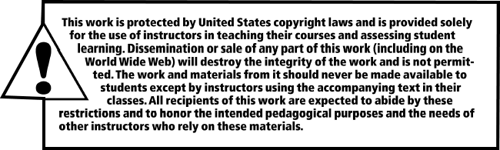
All rights reserved. No part of this publication may be reproduced, stored in a retrieval system, or transmitted, in any form or by any means, electronic, mechanical, photocopying, recording, or otherwise, without the prior written permission of the publisher. Printed in the United States of America.

